Slide 1
Microbial Enzymes

Slide 2
Enzymes in industry
Enzymes have several advantages over chemical catalysts:
The ability to function under relatively mild conditions of temperature, pH and pressure.
Enzymes are specific, often stereoselective, catalysts, which do not produce unwanted byproducts.
Enzyme-based processes are ‘environmentally friendly’
Certain enzymes are not restricted to aqueous environments and can operate in two-phase water–organic solvent systems and in non-aqueous organic media, particularly hydrophobic solvents.

Slide 3
Enzymes classification

Slide 4
Enzymes Applications

Slide 5
Bulk vs Fine microbial enzymes
Bulk Enzymes preparations
Bulk enzyme are partially purified and produced in large quantities
Bulk enzyme preparations are preferred for numerous and varied industrial processes.
Fine Enzyme preparations
Produced in smaller quantities
High-purity enzyme preparations
Required for numerous applications, such as therapeutic agents, many of which are now recombinant products

Slide 6
Bulk enzymes

Slide 7
Bulk industrial enzymes production

Slide 8
Fine microbial enzymes

Slide 9
Fine microbial enzymes

Slide 10
Food & feed industry

Slide 11
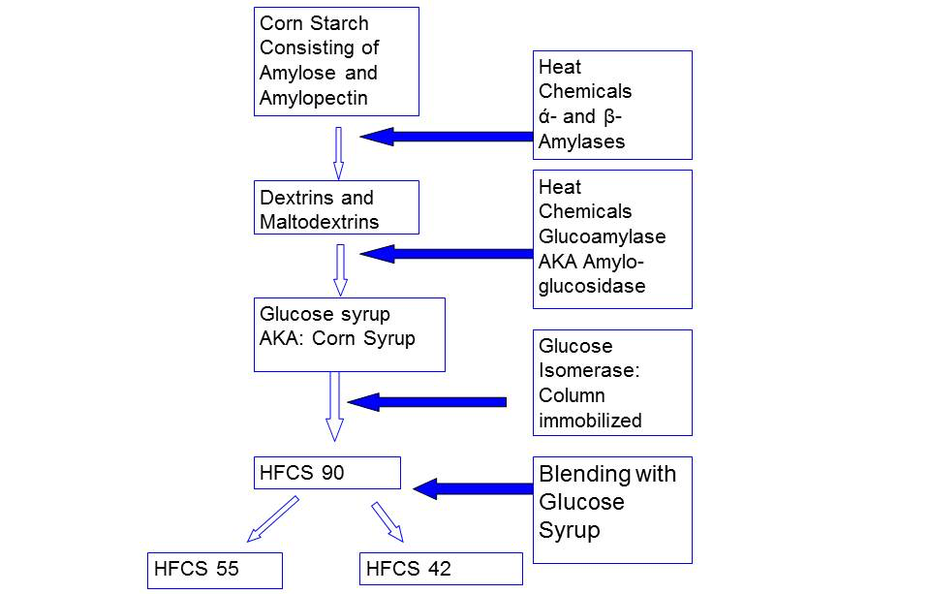
High Fructose Corn Syrup (HFCS)

Slide 12
Detergent industry
Proteases
Lipases
Cellulases
Amylases
Mannanases

Slide 13
Textile Industry
Desizing
Prior to weaving fabrics, the threads are reinforced with an adhesive (termed ‘size’) to prevent breakage of warp threads.
The size may be composed of starch or cellulose derivatives
Before dyeing, bleaching and printing, the size is removed from the cloth with amylases
Bioscourting
Untreated cotton contains varieties of cellulosic impurities like waxes, pectins, and hemicelluloses, which give hydrophobic properties to the fiber and thereby interfere in the process of dyeing and finishing.
Microbial enzymes like pectinases, proteases, lipases, and cutinases remove these impurities and enhance wettability of the fiber.

Slide 14
Textile Industry
Biopolishing
Cellulases are also employed in bio-polishing cotton and other cellulose fibres to produce fabrics with a smoother and glossier appearance
Denim washing
Treatment of denim garments to give a worn look be- fore sale is called ‘stonewashing’.
Cellulases are now used to accelerate abrasion and aid the loosening of the indigo dye.

Slide 15
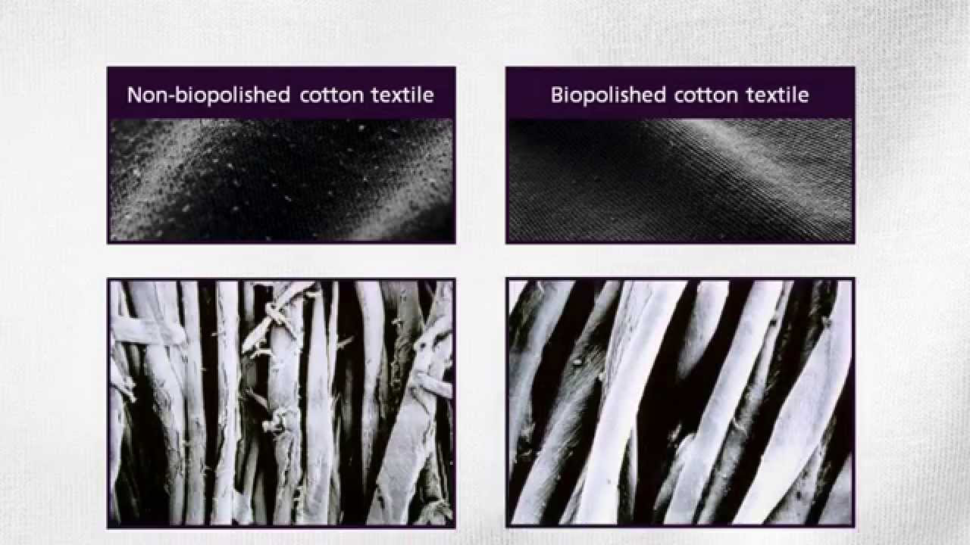
Textile Industry

Slide 16
Leather industry
The most important applications of microbial proteases and lipases during:
Soaking
De-hairing
De-greasing
Bating

Slide 17
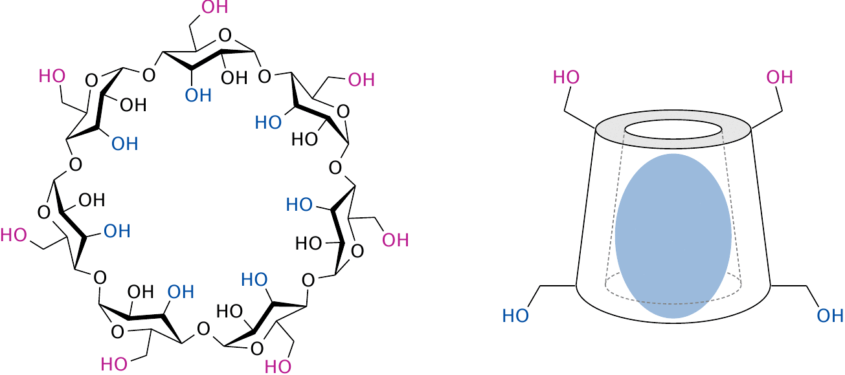
Enzymes as catalysts in organic synthesis
Microbial enzymes are used in the synthesis of high-value organic compounds for the chemical, food and pharmaceutical industries.
For example, cyclodextrin glycosyltransferases, create cyclodextrins from simple starch molecules.
Cyclodextrins are useful carriers of fragile compounds such as drugs, vitamins and flavours.
No chemical means exists for creating this class of substances, so the enzymatic route is unique.

Slide 18
Enzymes as catalysts in organic synthesis
An increasingly important field is the synthesis of chiral compounds.
Compounds are chemically synthesized an almost 50 : 50 mixture of enantiomers is made, which is called a racemic mixture.
In the industrial synthesis of chiral compounds, there have to be controls to guarantee the production of only the desired enantiomer, often at a purity higher than 99%.
Enzyme-based processes can be used to prepare specific enantiomers and resolve enantiomers from racemic mixtures.
These processes utilize racemases, which are a family of enzymes that accept either enantiomer, and function to turn a substrate of one chirality into its opposite form.

Slide 19
Pulp and Paper Processing
Paper is composed of natural biopolymers: cellulose, hemi-cellulose, and lignin.
Papermaking involves the use of chemicals to recover the cellulosic fibers.

Slide 20
Biofuel
Biofuels are defined as fuels derived from biomass conversion such as biodiesel, bioethanol, biohydrogen, and biogas.
Biodiesel (mono alkyl ester) of long-chain of fatty acid has immense potential as an alternative fuel
Lipase (Biodiesl) & Cellulase (Biobutanol, Bioethanol)

Slide 21
Enzymes immobilization
Advantages of enzyme immobilization:
Reuse
Suitability for application within continuous operations
Their product is enzyme free, therefore further processing to remove or inactivate the enzyme is not required
Improved enzyme stability
Reduced effluent disposal problems.

Slide 22
Enzymes immobilization

